Slide 1


EXPLORATORY DATA ANALYSIS (EDA)- CHOCOLATE BAR RATINGS

Slide 2

GROUP MEMBERS
PIUS SARFO BUOBU
MUMUNI SAMDEEN
GBODZI SELASI YAW
ANDREWS ACHEAMPONG

Slide 3
Outline
Understanding the business
Understanding the data
Cleaning the data
Questions
Analysis and presentation of findings

Slide 4
Understanding the business
Upon observations and considerations made. We came into the following conclusions
The dataset is about chocolate bar ratings.
It is owned by the Manhattan Chocolate Society
The principal objective of the Society is to taste, compare and discuss the qualities of fine chocolate

Slide 5
Understanding the Dataset
We realized that the dataset had 1795 rows across 9 distinct columns
The columns represented % 0f cacao in chocolate, origin of cocoa bean, ratings of chocolate bars, name of manufacturing companies, location of manufacturing companies, type of cocoa bean
HYPOTHESIS
There is no significant association between percentage of cocoa in chocolate and ratings of chocolate.

Slide 6
Questions???
Which country has the highest chocolate producing companies?
Which country/countries has/have the least number of chocolate manufacturing industries?
What is the most occurring “ratings” of the chocolate bars?
Find the relationship between the % of cocoa in chocolate and ratings of chocolate bars.

Slide 7
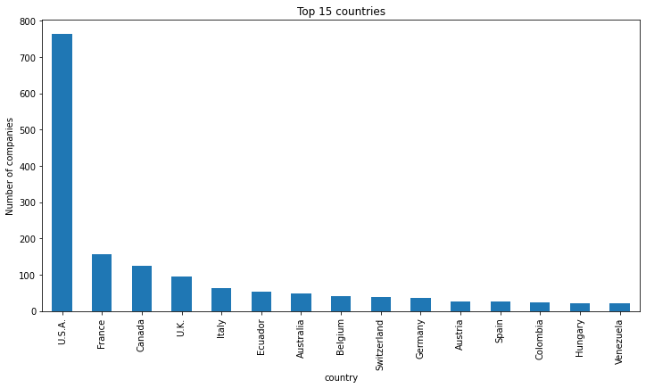
Analysis and Presentation of findings
Q1-Which country has the highest chocolate producing companies?

Slide 8
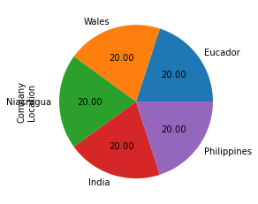
Cont’d
Q2-Which country/countries has/have the least number of chocolate manufacturing industries?

Slide 9
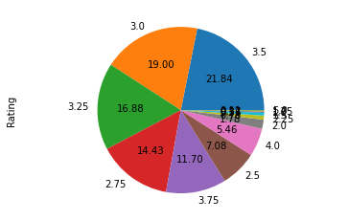
Cont’d
Q3-What is the most occurring “ratings” of the chocolate bars?

Slide 10
Summary of Findings
It was realized that majority of the chocolate producing companies are located in the United States
Also, most of the chocolate bars were rated 3.5

